Slide 2
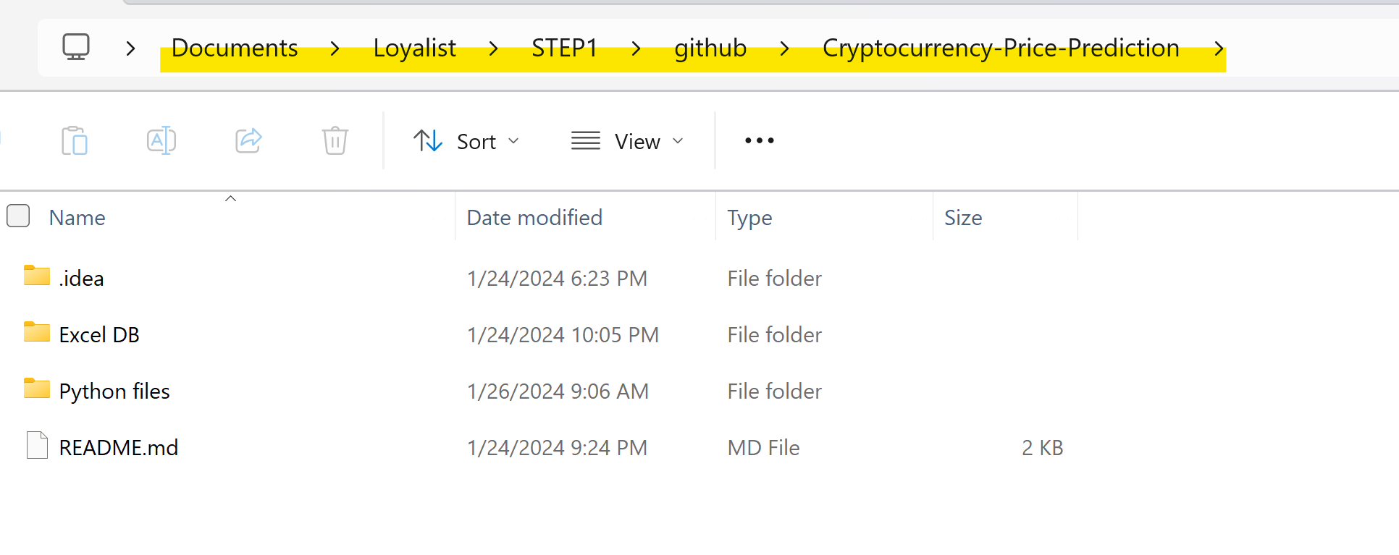
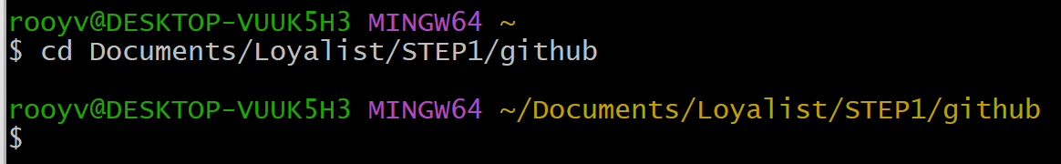
First Deliverable
Create a folder on your PC where you will clone the repository
Open Git Bash and locate yourself within that path using:
cd “Path” (You can copy the path and paste it, for Git Ctr+Shift+ins for paste)

Slide 3
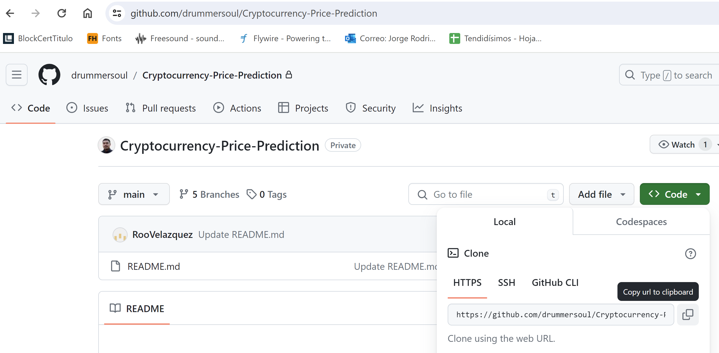
First Deliverable
Now copy the repository HTTPS

Slide 4
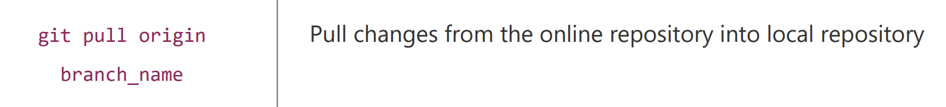
First Deliverable
Now clone the repository on your local machine with:
git clone “https”
This will create a local copy of the repository on your machine
To download the latest changes you can do a pull request

Slide 5
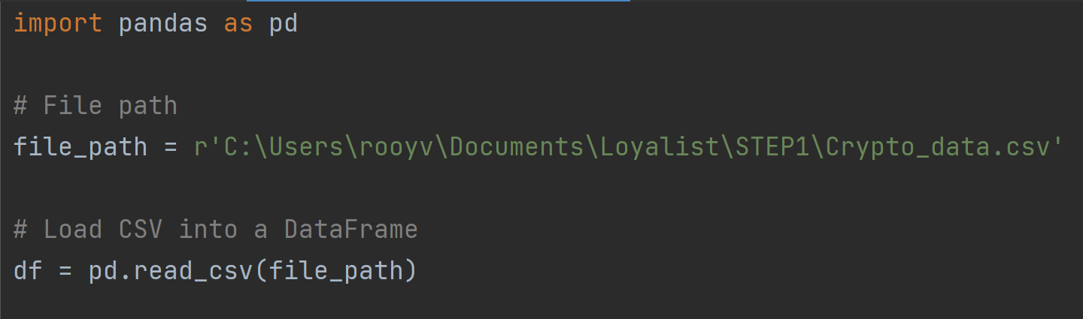
First Deliverable DB
Now Create a python program to obtain some insights or summary of the data, count, min, max, average, return names of cryptos…
Youll need to already have the database downloaded on your PC, on python you can use the pandas module to read CSV (coma separated values)

Slide 6
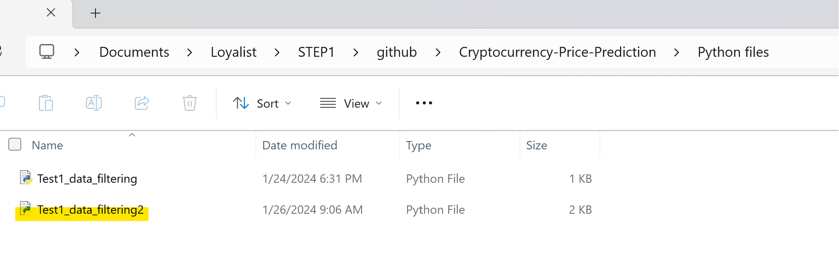
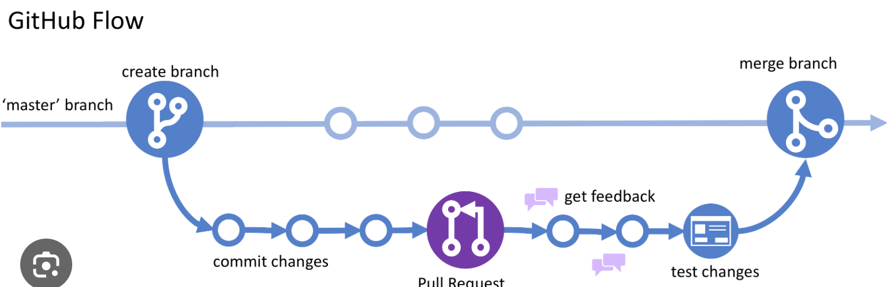
Create a new folder within your repository copy and save that file.
Best practice “python_files”
Now return to the Git Bash terminal, lets create a new branch

Slide 7
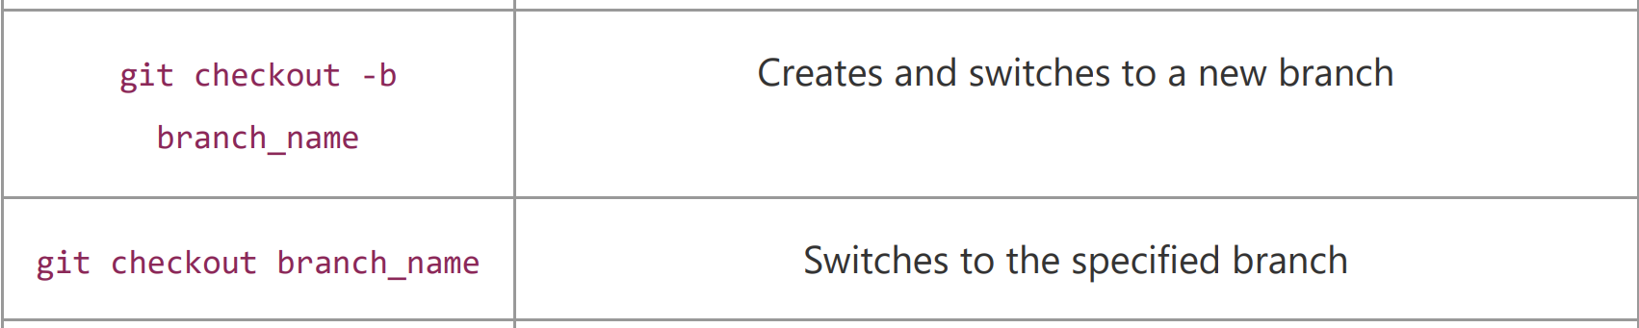
When you saved your python file in the new folder you created within the repository, you already made changes to the repository on your local machine, now we need to do something with this new version:
So first we create a new branch where we are going to be working to avoid affecting the main branch.
We can move from branch to branch with the checkout command, similar to the cd command to select a folder on our machine.
By using the following command we will move from branch and also we will create it at the same time:
git checkout –b “first_deliverable_yourname”

Slide 8
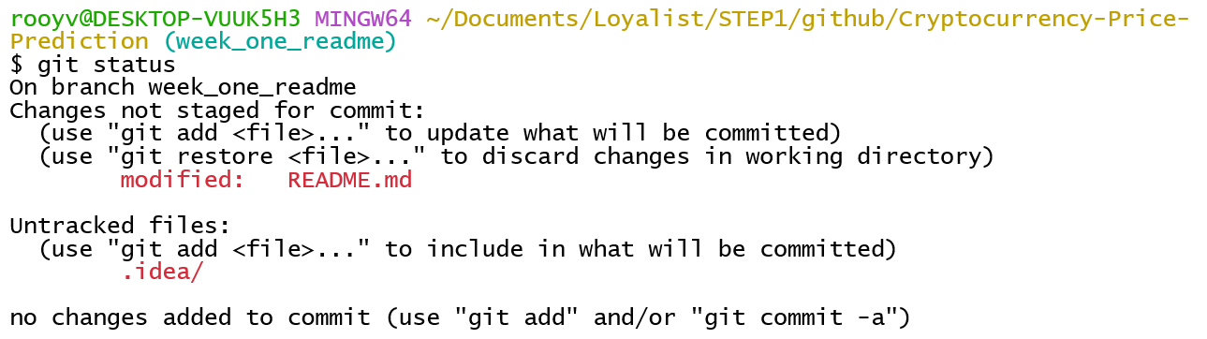
So far you created a new branch from the main branch where you added your python file that access the database and returns a summary of the data, but all this is only on your local pc, until now…
We can use the git status command to review what do we need to push into the online repository, whats the difference between the two.
Now use the git add “name of your file” To send those files to the staging area to load or modify into the repository branch you’re in.

Slide 9
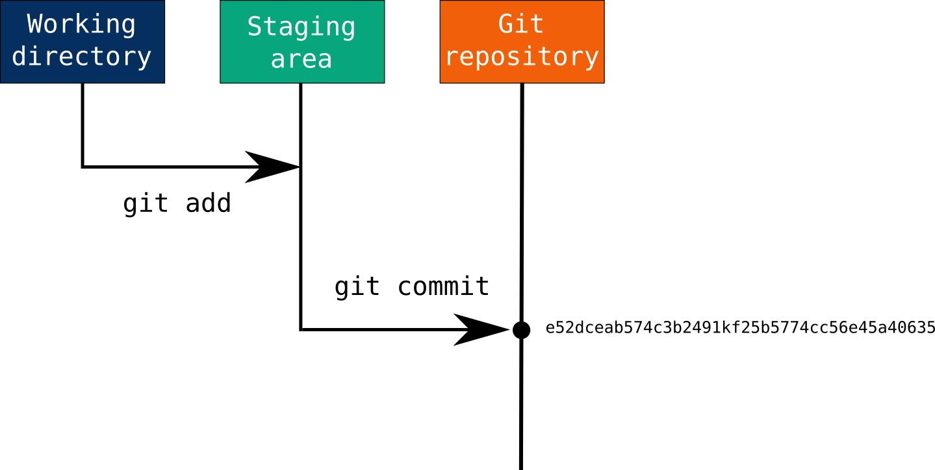

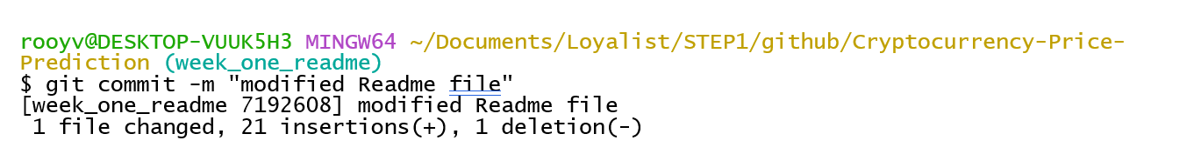
Adding is not enough…
You need to commit!!
You can use git commit –m “description of change” command

Slide 10

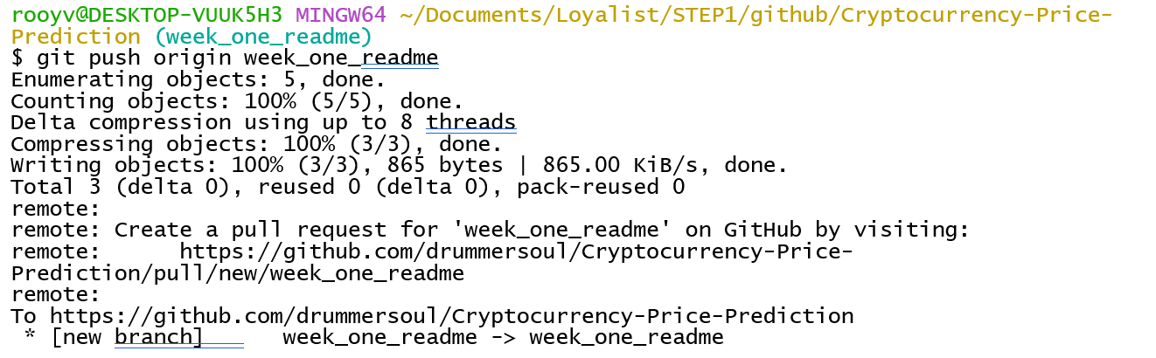
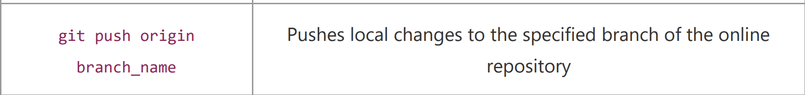
And now you’re ready to push your changes into the repository
git push origin “branch name”

Slide 11
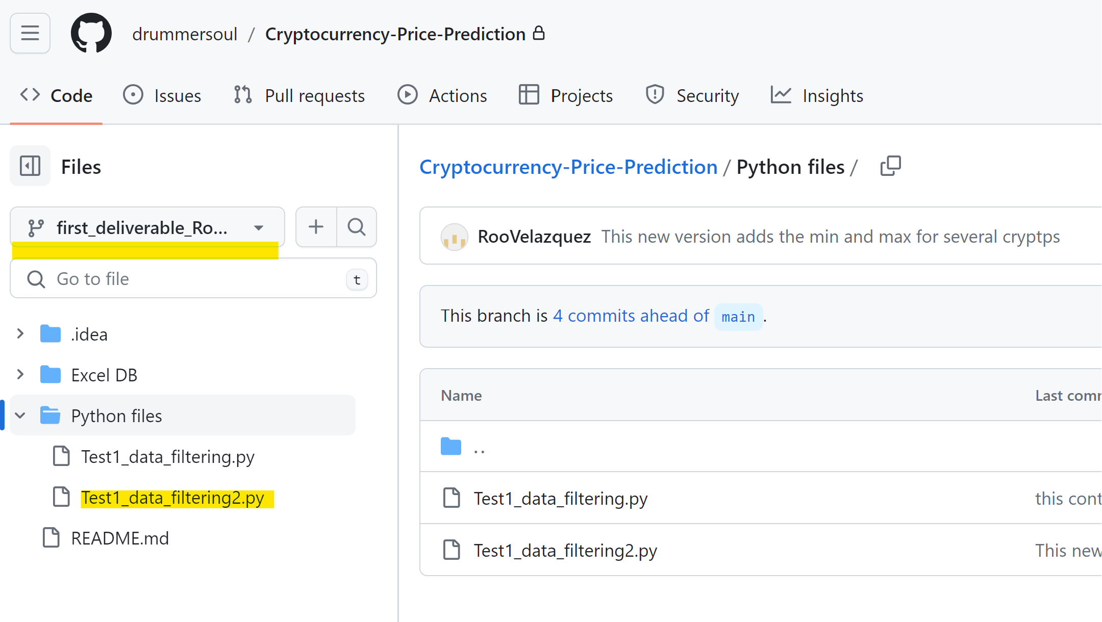
Verify your changes on the online repository

Slide 12
Next Steps
Play with your code to have something more complex.
Vibek to teach how to add a colaborator and that person should invite Saeed: Saeed.Sojasi@tbcollege.com
Everyone to create a slide answering the questions about the DB and load it into GitHub on your own branch.
Questions for database and project
1-How do we obtain the marketcap column values?
2-Are we going to predict the open/close/ high -low price?
3-How many values do we have for each crypto?
4-Which crypto do we have on the database?
5-Whats our time frame of data (start-end)?
6-Is it possible to predict crypto price?
7-[List any challenges encountered during data exploration and how they were addressed.]

Slide 13
Rodrigo Velazquez
Questions for database and project
1-How do we obtain the marketcap column values?
It’s obtained by multiplying the number of coins in circulation by the current market price of a single coin, the number of coins should be different from the value column as we have some 0 values, but we will need to investigate a little further on that.
2-Are we going to predict the open/close/ high -low price?
The correct idea would be to predict the close price as it’s the price recorded on the historical data.
3-How many values do we have for each crypto?
We have 56 different cryptos, each crypto has a different size of records and date frames.
4-Which crypto do we have on the database?
Bitcoin, Litecoin, XRP, Dogecoin, Monero, Stellar, Tether, Ethereum…
5-Whats our time frame of data (start-end)?
After exploring I saw it depends on the crypto, but the general limits are from May 5th 2013 to Oct 23rd 2022
6-Is it possible to predict crypto price?
According to some other similar projects, it is possible to predict a price estimation based on the historical data for cryptos, however as it is a very volatile market and it’s impossible to anticipate major external factors that might impact the price, similar to a meme getting popularity or the impacts of the pandemic on the crypto prices.
7-[List any challenges encountered during data exploration and how they were addressed.]
-By default excel wants to convert large numbers into scientific notation, which would introduce noise on our model, so we need to make sure that doesn’t happens.
Not all the cryptos have the same size of sampling , we have some that have more historical data than others, but as we would predict the price for an individual crypto, we might select the top 3 with more data available so we can have a representative sample that we can also divide properly as training and testing data.

